Slide 1


Slide 2




Slide 3



BINARY SEARCH TREE
IN
JAVA

Slide 4
BINARY SEARCH TREE IN JAVA
Binary Search Tree
It is a node-based binary tree data structure which has the following properties
The left subtree of a node contains only nodes with keys lesser than the node’s key
The right subtree of a node contains only nodes with keys greater than the node’s key
The left and right subtree each must also be a binary search tree

Slide 5
EXAMPLE
Average depth of a node is O(log N); maximum depth of a node is O(N)
Notes:
[Z, PQ, N, O, KK, FGH]

Slide 6
EXAMPLE
Basic Operations:
Following are the basic operations of a tree
Search − Searches an element in a tree
Insert − Inserts an element in a tree
Pre-order Traversal − Traverses a tree in a pre-order manner
In-order Traversal − Traverses a tree in an in-order manner
Post-order Traversal − Traverses a tree in a post-order manner
Notes:
[Z, PQ, N, O, KK, FGH]

Slide 7
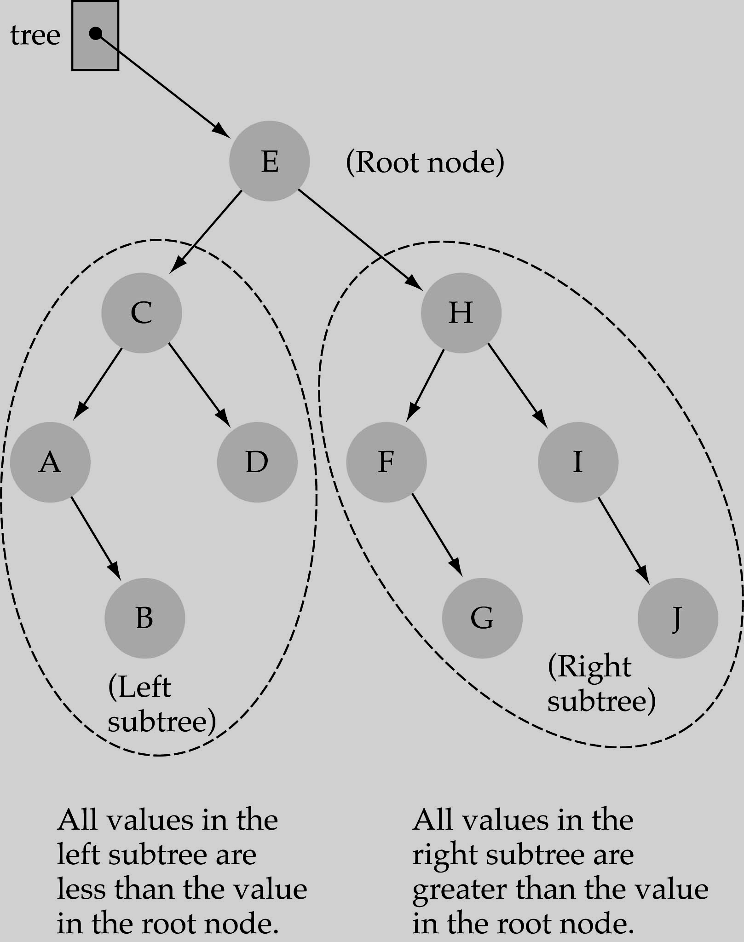
HOW TO SEARCH A BINARY SEARCH TREE ?
Start at the root
Compare the value of the item you are searching for with the value stored at the root
If the values are equal, then item found; otherwise, if it is a leaf node, then not found
If it is less than the value stored at the root, then search the left subtree
If it is greater than the value stored at the root, then search the right subtree
Repeat steps 2-6 for the root of the subtree chosen in the previous step 4 or 5

Slide 8
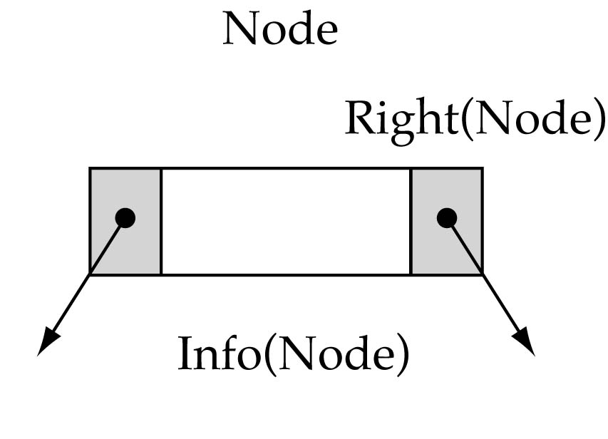
TREE NODE STRUCTURE

Slide 9
LOGIC
// Returns whether this BST contains the given integer. public boolean contains(int value) { return contains(RootNode, value); } private boolean contains(IntTreeNode node, int value) { if (node == null) { return false; // base case: not found here } else if (node.data == value) { return true; // base case: found here } else if (node.data > value) { return contains(node.left, value); } else { // root.data < value return contains(node.right, value); } }
Notes:
Original contents of al: C A E B D F

Slide 10
OPERATIONS IN BST
Searching
Inserting
Deleting
Tree Traversal

Slide 11
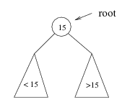
OPERATIONS IN BST
Searching:
If we are searching for 15, then we are done
If we are searching for a key < 15, then we should search in the left subtree
If we are searching for a key > 15, then we should search in the right subtree

Slide 12
SEARCHING OPERATION IN BST
If root == NULL return NULL; If number == root - > data return root - > data; If number < root - > data return search(root - > left) If number > root - > data return search(root - > right)

Slide 13
INSERTING OPERATION IN BST
Inserting a value in the correct position is similar to searching because we try to maintain the rule that left subtree is lesser than root and right subtree is larger than root
We have attached the node but we still have to exit from the function without doing any damage to the rest of the tree
This is where the return node; at the end comes in handy. In the case of NULL, the newly created node is returned and attached to the parent node, otherwise the same node is returned without any change as we go up until we return to the root

Slide 14
INSERTING OPERATION IN BST
If node == NULL return createNode(data) if (data < node - > data) node - > left = insert(node - > left, data); else if (data > node - > data) node - > right = insert(node - > right, data); return node;

Slide 15
DELETE OPERATION IN BST
First, find the item; then, delete it
Binary search tree property must be preserved!!
We need to consider three different cases
(1) Deleting a leaf
(2) Deleting a node with only one child
(3) Deleting a node with two children

Slide 16
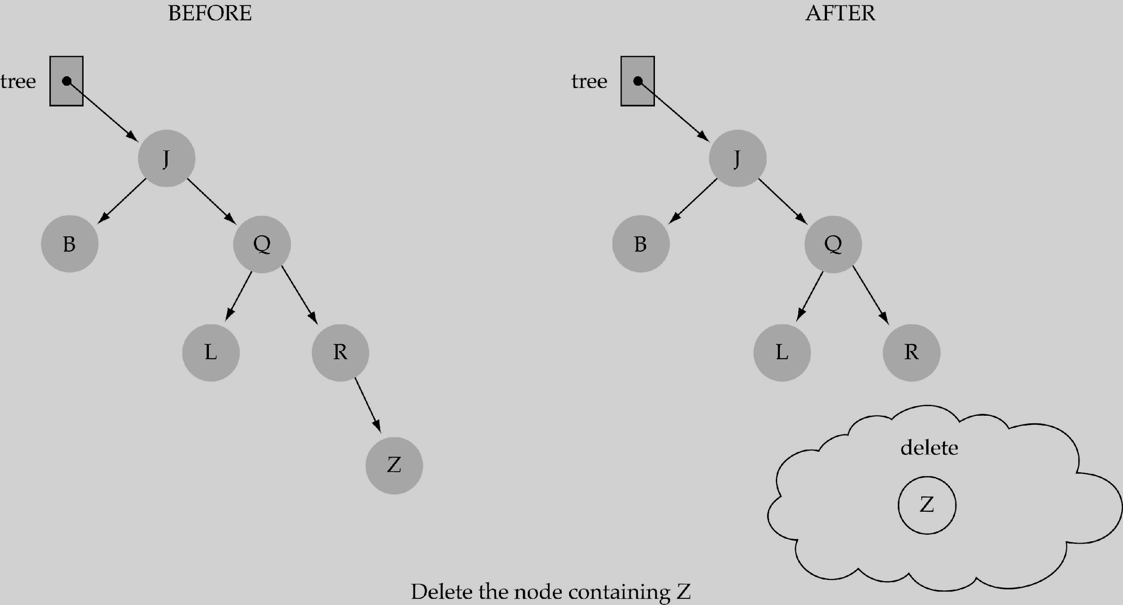
DELETE OPERATION IN BST
Deleting a leaf

Slide 17
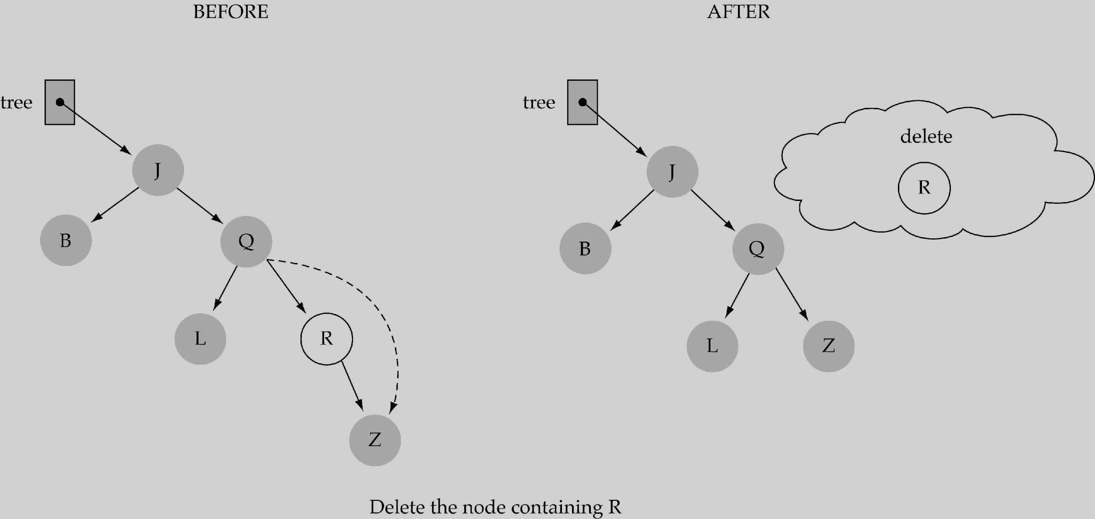
DELETE OPERATION IN BST
2. Deleting a node with only one child

Slide 18
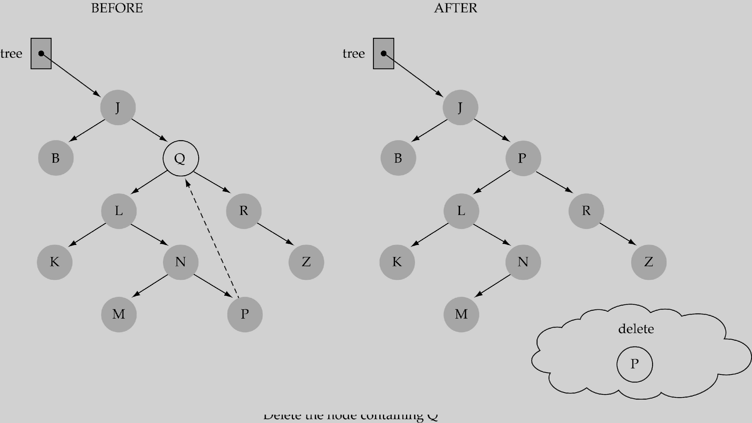
DELETE OPERATION IN BST
3. Deleting a node with two children

Slide 19
TREE TRAVERSAL OPERATION IN BST
Unlike linear data structures (Array, Linked List, Queues, Stacks, etc) which have only one logical way to traverse them, trees can be traversed in different ways
There are mainly three ways to traverse a tree
Inorder Traversal
Postorder Traversal
Preorder Traversal

Slide 20
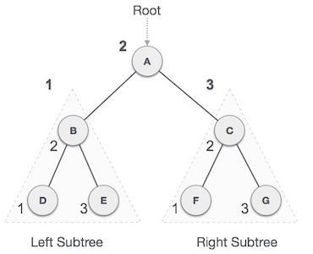
IN-ORDER TRAVERSAL OPERATION IN BST
In this traversal method, the left subtree is visited first, then the root and later the right sub-tree. We should always remember that every node may represent a subtree itself
If a binary tree is traversed in-order, the output will produce sorted key values in an ascending order
We start from A, and following in-order traversal, we move to its left subtree B. B is also traversed in-order
The process goes on until all the nodes are visited. The output of inorder traversal of this tree will be −
D → B → E → A → F → C → G

Slide 21
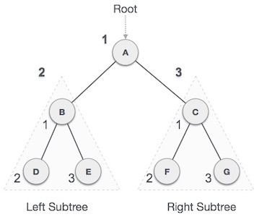
PRE-ORDER TRAVERSAL OPERATION IN BST
In this traversal method, the root node is visited first, then the left subtree and finally the right subtree
We start from A, and following pre-order traversal, we first visit A itself and then move to its left subtree B
B is also traversed pre-order
The process goes on until all the nodes are visited. The output of pre-order traversal of this tree will be −
A → B → D → E → C → F → G

Slide 22
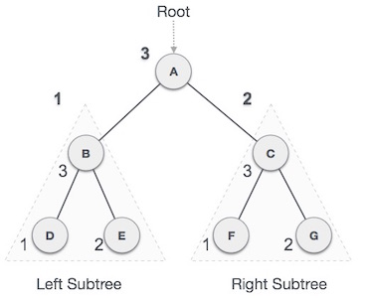
POST-ORDER TRAVERSAL OPERATION IN BST
In this traversal method, the root node is visited last, hence the name
First we traverse the left subtree, then the right subtree and finally the root node
We start from A, and following Post-order traversal, we first visit the left subtree B. B is also traversed post-order
The process goes on until all the nodes are visited. The output of post-order traversal of this tree will be −
D → E → B → F → G → C → A

Slide 23

THANK YOU

